Slide 1
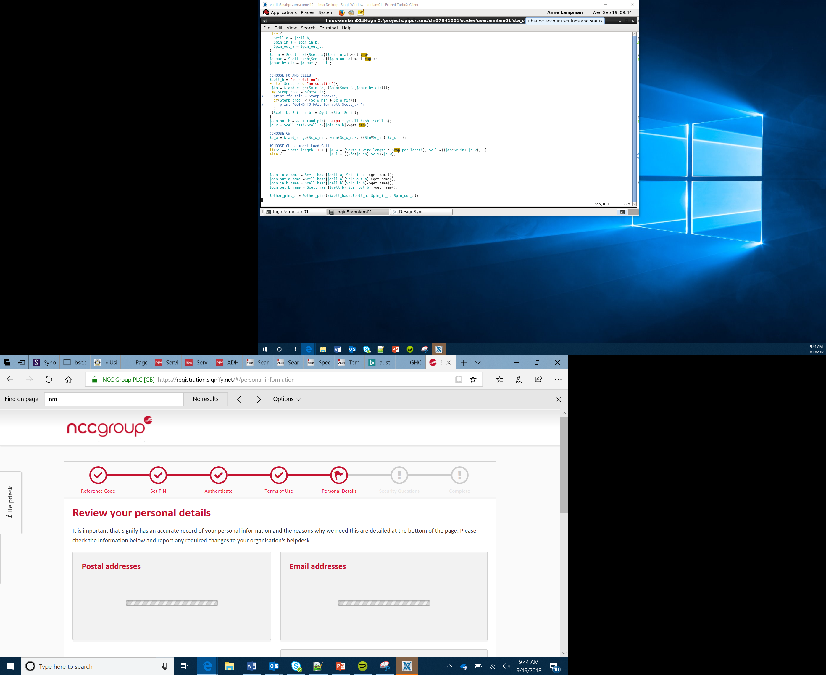

Algorithms
Lesson 3

Slide 2
Algorithms
An algorithm is a series of step by steps instructions which solve a problem
We follow algorithms everyday, for example when making a drink
Can you think of any other algorithms that you follow?
Notes:
Other examples could be getting ready for school, making a simple meal, getting to school etc

Slide 3
Bugs
A bug is an error in a computer program
Sometimes a bug may cause a computer program to stop running altogether
At other times a bug may cause an unexpected output to be given by a system, for example:
If we asked a computer program to carry out the calculation 5 + 4 and it output 10 this would show us that there was a bug in our program
It is important to test programs to try to remove any bugs before we start to use it
One method of reducing the number of bugs in our program is to plan out the processes before we start to write our actual program. One way of doing this is to use a flow chart

Slide 4
Flow Chart Symbols (1)
All flow charts should begin with a start and finish with an end. A lozenge shape is used for this.
When a piece of data is to be input or output from a system a parallelogram is used
Start
End
Input
Output

Slide 5
Flow Chart Symbols (2)
When a piece of data needs to be processed a rectangle is used
When a decision is needed a diamond is used
Process
Decision
Yes
No

Slide 6
Example Flow Chart For a Simple Calculator
Start
Input Num1
Input Num2
Add or multiply?
Add
Ans=Num1+Num2
Multiply
Ans=Num1*Num2
Output Ans
End

